Slide 1



Department of Computer Science and Engineering
DESIGN AND PRELIMINARY DATA ACQUISITION FOR AN AI ENABLED FOREST FIRE SENSING SYSTEM WITH IOT: A STUDY ON MODEL SELECTION AND SENSOR INTEGRATION
Mr. K. DEEPAK KUMAR ASSISTANT PROFESSOR
B21A2425C16
MANOJ MG 210701149
MERCY N 210701157

Slide 2
Problem Statement and Motivation
Forest fires pose significant threats to ecosystems, impacting
both
biodiversity and human safety. Traditional detection methods, such as satellite and visual monitoring, often result in delayed responses, allowing fires to spread uncontrollably. This project addresses the need for an early warning system by developing an IoT-based framework that continuously monitors environmental conditions using a network of temperature, humidity, smoke, and acoustic sensors connected to an ESP32 microcontroller. By gathering real-time data and applying machine learning models, this study aims to establish a foundational system for reliable forest fire detection. The insights from this preliminary phase will guide further improvements, creating a scalable, AI-enabled solution for proactive wildfire management.

Slide 3
Objectives
Develop an IoT-Based Sensor Network.
Collect and Process Real-Time Data.
Implement Machine Learning for Early Detection.
Ensure Scalability and Robustness of the System.
Optimize Data Acquisition for Model Training.
Lay the Groundwork for Real-World Applications.

Slide 4
Abstract
Forest fires are one of the most unplanned disasters that trigger extreme destructions in the different ecosystems of animals and humans. Early detection coupled with proper measures is very vital in controlling such uncontrolled disasters. The title of this project is "Design and Preliminary Data Acquisition for an AI Enabled Forest Fire Sensing System with IOT: A Study on Model Selection and Sensor Integration" and its aim is to develop a foundational framework for a reliable wild fire detection system using IoT technologies. This project uses a network of sensors including humidity, temperature, smoke and along with acoustic sensors using an ESP32 microcontroller that maintains the environmental condition monitoring all the time. This development phase is based on data gathering and training for machine learning models in sensor data for potential fire detection. Results of this study will now be used in further improvements and optimizations to ensure the system is robust and scalable. This project takes advantage of the opportunities presented by IoT and machine learning to provide an effective early warning system for forest fires, which could lead to advanced monitoring and response strategies.

Slide 5
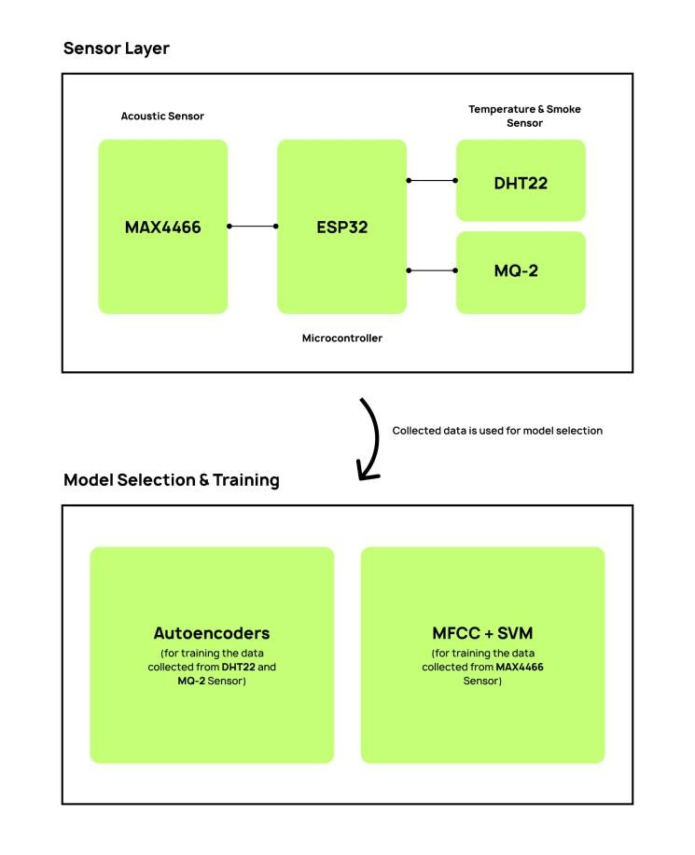
System Architecture

Slide 6
List of Modules
System Initialization Module
Sensor Data Acquisition Module
Data Preprocessing Module

Slide 7
System Initialization Module
The System Initialization Module sets up
the ESP32 and initializes
communication with each sensor (DHT22, MQ-2, MAX4466). This module establishes the connections, sets up GPIO pins, configures libraries for each sensor, and initializes any necessary variables for data collection. Additionally, it connects the ESP32 to the Wi-Fi network (if available) to enable remote data transmission in later modules.

Slide 8
Sensor Data Acquisition Module
The Sensor Data Acquisition Module is responsible for reading data from the sensors at regular intervals. This module captures temperature, humidity, smoke, and acoustic levels and timestamps each reading for future analysis. The data acquisition process includes error-checking to ensure that sensor values are within realistic ranges, and it flags any irregular data points for review.

Slide 9
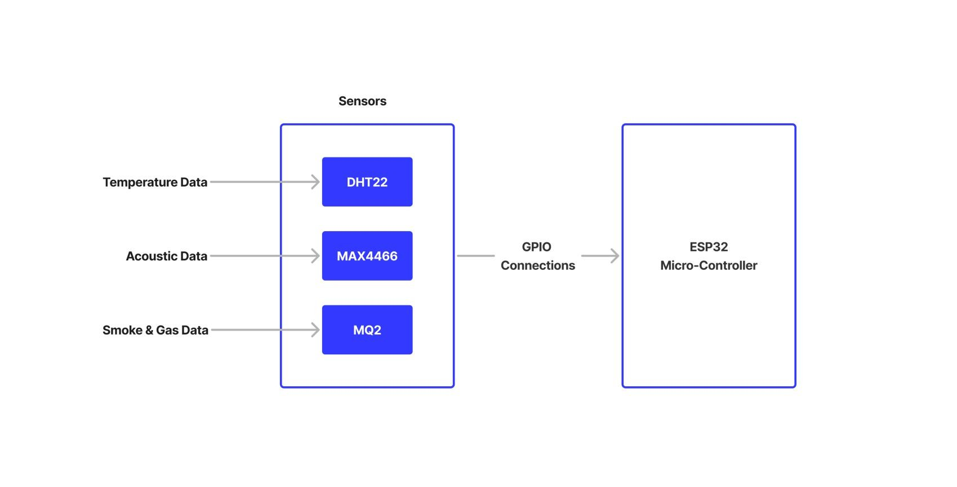
Data Flow Diagram

Slide 10
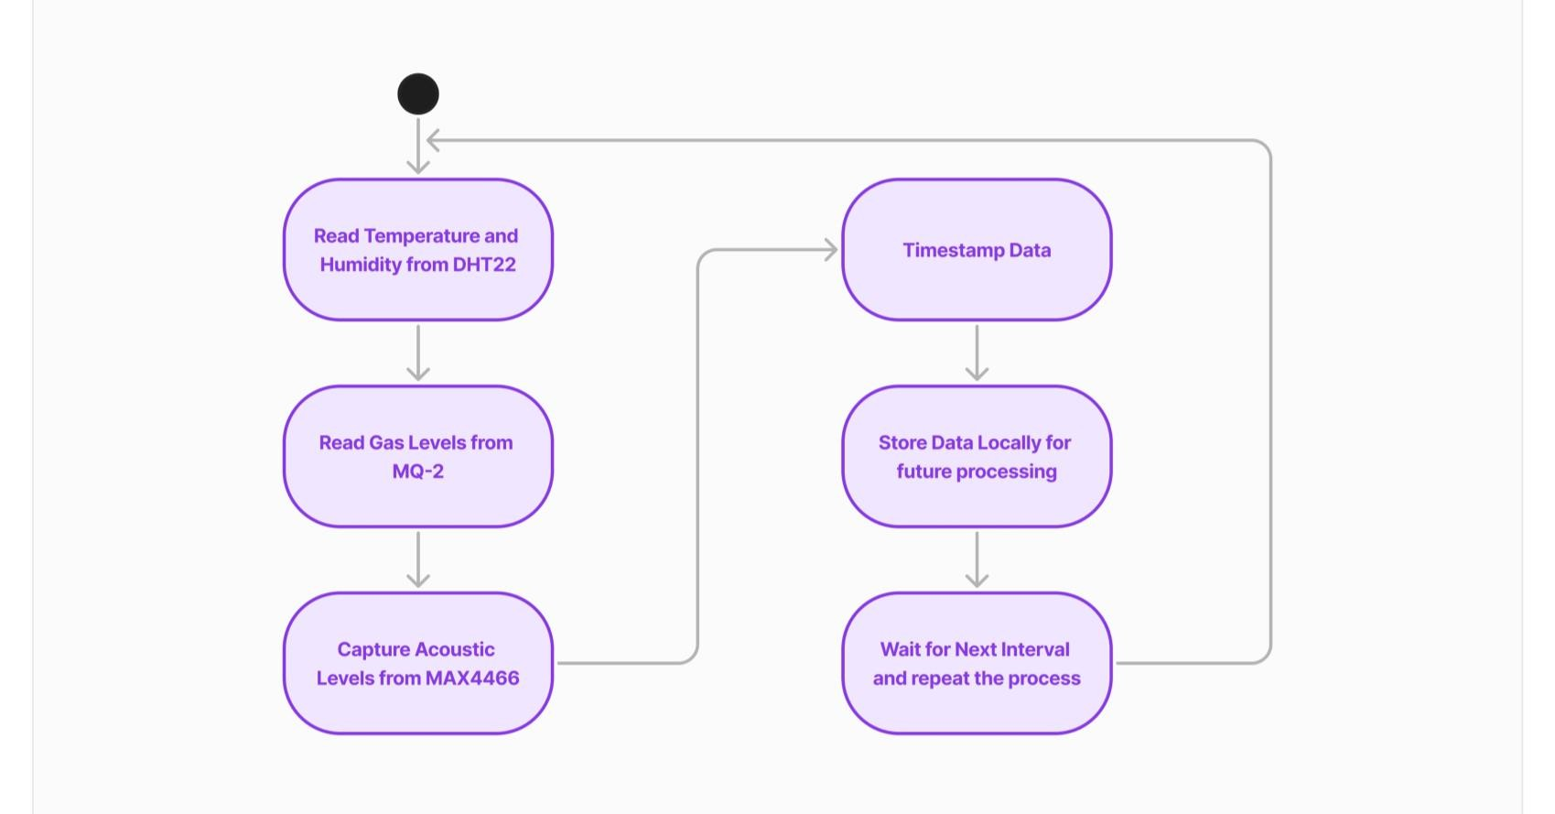
Activity Diagram

Slide 11
Data Preprocessing Module
The Data Preprocessing Module prepares raw sensor data for analysis by performing cleaning and normalization. This module removes noise or outliers in the data, particularly from the acoustic sensor, and scales or normalizes values as needed to ensure uniformity across data types. The preprocessed data is then formatted and saved, ready for future training or analysis by machine learning models.

Slide 12
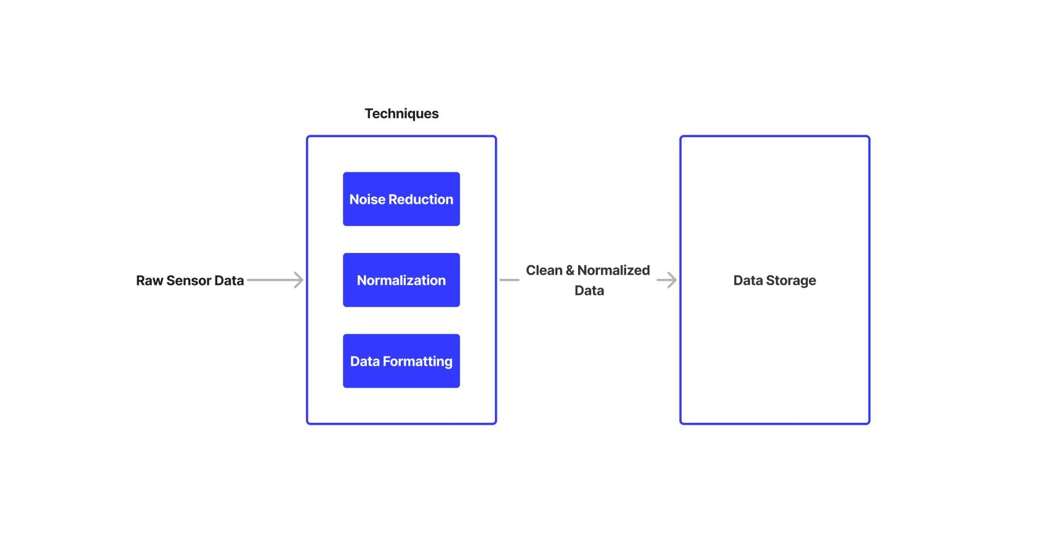
Data Flow Diagram

Slide 13
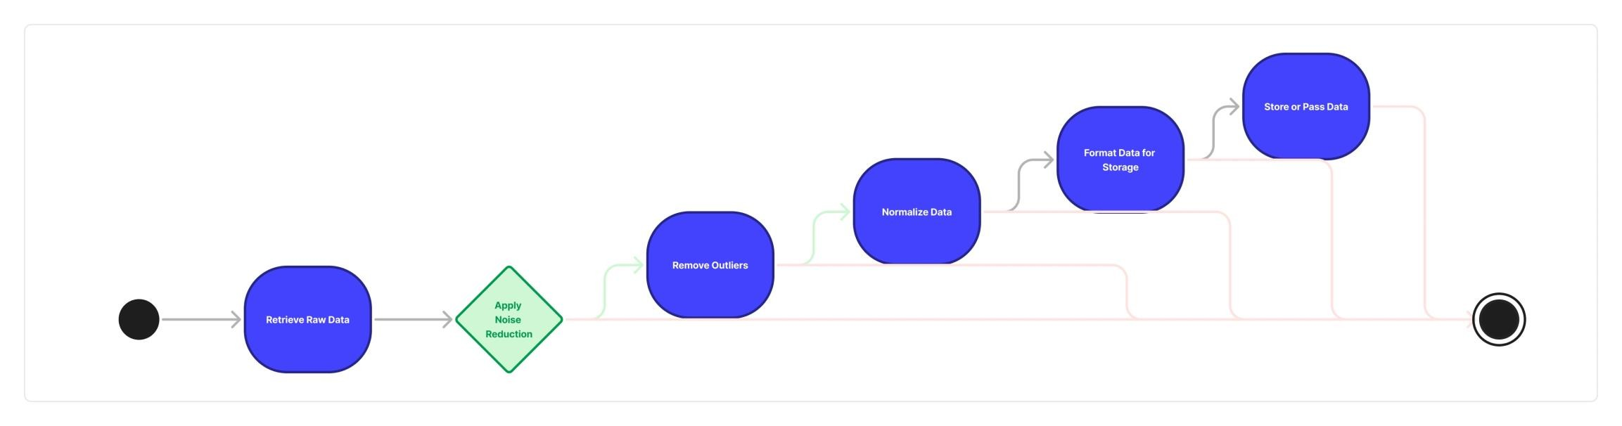
Activity Diagram

Slide 14
Implementation
ESP32 and Sensors Working
The ESP32 microcontroller acts as the core of the IoT-based forest fire detection system. It accepts sensor data, processes parts of it and sends this to the Raspberry Pi where machine learning models are processed, for example. Here, how the ESP32 interfaces with each sensor.
DHT22 (Temperature & Humidity Sensor): The DHT22 measures temperature in real-time and also humidity. Data rea d from this sensor is periodically sent to ESP32 for monitoring conditions that might indicate the onset of increased risk of forest fire: such as high temperature and low humidity. Data read from DHT22 is done periodically with an interval of 5 seconds.
MQ-2 (Smoke Sensor): MQ-2 detects whether there is smoke or flammable gases (like methane, propane, and butane). The sensor's analog signal depends on the concentration of smoke and gases; then it is converted into digital data by the ESP32, which are further processed.

Slide 15
Implementation
MAX4466 (Acoustic Sensor): The microphone sensor records the ambient noises with crackling sounds, which may be due to burning leaves and trees in a forest fire. The ESP32 converts these sounds into digital formats and sends the data for further processing.
All the sensor data are wirelessly sent to the Raspberry Pi via Wi-Fi using the ESP32. This ESP32 model is chosen because of low power consumption, multiple I/O pins, and inbuilt wireless capabilities such as Wi-Fi and Bluetooth.

Slide 16
Implementation
Model Selection & Training
a. Autoencoders for Sensor Data (DHT22 & MQ-2)
□ Autoencoders are a model of neural networks used for unsupervised learning. They have proved to be extremely efficient in such tasks as anomaly detection. Your application might really benefit from it because the model needs to be able to recognize the abnormal conditions such as very high temperature, low humidity, or the high level of smoke, would indicate the first signs of a forest fire.
Input Data: The autoencoder takes in sensor data like temperature, humidity, and gas readings as input.
Encoder Component: This neural network component compresses the sensor data into lower dimensionality. The idea is to learn the most important features of the data-for example, correlations between temperature, humidity, and gas concentration.

Slide 17
Implementation
Decoder Part: The decoder will take this compressed form of data and reconstruct it back into its original dimensions. In training, the model will have minimized the difference between the input and reconstructed data.
Anomaly Detection: During real-time running, this autoencoder would be getting new sensor data and trying to reconstruct this data. When the error between original and reconstructed data was high enough, the system marked it as an anomaly (for example, conditions favorable to fire).
Training Process:
Acquire a large dataset of non-fire scenarios.
Train an autoencoder to reconstruct sensor data from normal conditions with a minimum error.
Test with normal and anomalous data - forest fire or fire-like conditions - to validate the model.

Slide 18
Implementation
b. MFCC and SVM for Acoustic Sensor Data (MAX4466)
For acoustic forest fire detection, Mel Frequency Cepstral Coefficients (MFCC) are used for feature extraction from the audio signals captured by the MAX4466 microphone. The characteristics of sound would determine some specific sounds, like crackling noises from fire,
Feature Extraction using MFCC:
The MFCC algorithm transforms a raw audio signal into features of the frequency and intensity of sounds. These features are easily applicable for applications such as sound recognition and are widely used in speech and audio processing.
Analysis of the frequency components that appear during the processing of the audio with the use of MFCC contains some unique signatures that can be useful for fire-related sounds, for example, crackling.

Slide 19
Conclusion & Work for Phase II
Effective design and preliminary data acquisition for an IoT-based forest fire detection system have been established as the basis for any scalable, efficient fire monitoring solution. This initial phase was enough to prove that ESP32, with environmental and acoustic sensors, would be useful in continuous data acquisition. They constitute the basic form on which future models will be trained and by which future systems could benefit from improvement. Early results indicated promising prospects for the autoencoders for environmental sensor data and MFCC with SVM for acoustic analysis, which had 94% accuracy on reconstruction of normal environmental conditions, indicating very promising potential for anomaly detection. Similarly, the MFCC-based SVM model was performing well enough on classification of the sound patterns across different data sets, thus promising well towards development of a specific fire sound classifier in future phases. Even though this system is in its nascent stage, it has a tremendous potential for fine-tuning toward real-time forest fire detection. This aspect of using low- power hardware such as ESP32 ensures that this system will aptly be deployed in remote areas of forests with a reliable energy-efficient wildfire monitoring solution. Future work will be toward optimizing the system further and incorporating real-time alert mechanisms to enhance the chances of responding to any future fire threats.

Slide 20
Work for Phase II
In Phase II, the project involves preprocessing the collected sensor data and selecting suitable machine learning models. Raw data from temperature, humidity, smoke, and acoustic sensors is cleaned, normalized, and prepared for training. Autoencoders are used to detect anomalies in environmental data, while MFCC features with SVM or Random Forest algorithms classify acoustic signals. These trained models are deployed on the Raspberry Pi, enabling real-time forest fire detection and communication with the monitoring dashboard.

Slide 21
References
[1] Y. Zheng, G. Zhang, S. Tan, Z. Yang, D. Wen, and H. Xiao, "A forest fire smoke detection model combining convolutional neural network and vision transformer," in Frontiers in Forests and Global Change, vol. 6, Fire and Forests section, Apr. 17, 2023.
[2] K. Nakau, M. Fukuda, K. Kushida, H. Hayasaka, K. Kimura, and H. Tani, "Forest fire detection based on MODIS satellite imagery, and comparison of NOAA satellite imagery with firefighters' information," in Proc. IARC/JAXA Terrestrial Team Workshop, 2006. Av
[3] S. Verma, S. Kaur, D. B. Rawat, C. Xi, L. T. Alex and N. Zaman Jhanjhi, "Intelligent Framework Using IoT-Based WSNs for Wildfire Detection," in IEEE Access, vol. 9, pp. 48185-48196, 2021
[4] E. Jang, Y. Kang, J. Im, D.-W. Lee, J. Yoon, and S.-K. Kim, "Detection and monitoring of forest fires using Himawari-8 geostationary satellite data in South Korea," Remote Sensing, vol. 11, no. 3
[5] R. Ghali, M. A. Akhloufi, and W. S. Mseddi, "Deep learning and transformer approaches for UAV-based wildfire detection and segmentation," Sensors, vol. 22, no. 5, p. 1977, 2022.

Slide 22
References
[6] N. Maeda and H. Tonooka, "Early stage forest fire detection from Himawari-8 AHI images using a modified MOD14 algorithm combined with machine learning," Sensors, vol. 23, no. 1
[7] S. Treneska and B. R. Stojkoska, "Wildfire detection from UAV collected images using transfer learning," in Proc. 18th International Conference on Informatics and Information Technologies, Skopje, North Macedonia, 2021
[8] M. M. Fouda, et al., "A lightweight hierarchical AI model for UAV-enabled edge computing with forest-fire detection use case," IEEE Network, vol. 36, no. 6, pp. 38–45, 2022. [9] J. S. Almeida, et al., "Edgefiresmoke: A novel lightweight CNN model for real-time video fire–smoke detection," IEEE Transactions on Industrial Informatics, vol. 18, no. 11, pp. 7889 7898, 2022
[9] J. S. Almeida, et al., "Edgefiresmoke: A novel lightweight CNN model for real-time video fire–smoke detection," IEEE Transactions on Industrial Informatics, vol. 18, no. 11, pp. 7889 7898, 2022.
[10] M. Varun, et al., "Integrating IoT and machine learning for enhanced forest fire detection and temperature monitoring," in Proc. 2023 3rd International Conference on Innovative Mechanisms for Industry Applications (ICIMIA), 2023.

Slide 23
Paper Publication Status
LIST OF PUBLICATIONS
Publication Status: Submitted
Title Of The Paper: Leveraging IoT and Machine Learning for Next Generation Forest Fire Detection Systems
Authors: Deepak Kumar K, Senthil Pandi S, Kumar P, Manoj M G and Mercy N
Name of the conference: International Conference On Advancement In Communication And Computing Technology (INOACC).
Conference Date: 4th April, 2025

Slide 24
Thank You

